Slide 1
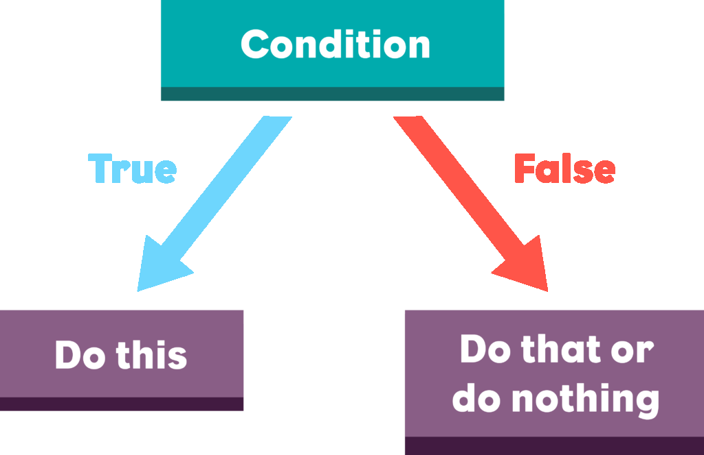

Conditional Statements
SoftUni
Training Team
Software University
https://softuni.bg

Slide 2
Table of Contents
Logical expressions
Boolean type
Relational operators: <, >, ==, !=, …
The if-else statements
Chaining – if-else
Variable scope
The switch-case statement
Debugging
2

Slide 3

Recap

Slide 4
Recap
What is the type of the variable:
... letter = 'a';
char[]
int
char
double
4

Slide 5
Recap
What is the type of the variable:
... letter = 'a';
char[]
int
char
double
5

Slide 6
Recap
What is the type of the variable:
... number = "1000";
char[]
int
char
double
6

Slide 7
Recap
What is the type of the variable:
... number = "1000";
char[]
int
char
double
7

Slide 8
Recap
What the actual output will be?
printf("%d\n", 10 % 3);
1
10
0
3
8

Slide 9
Recap
What the actual output will be?
printf("%d\n", 10 % 3);
1
10
0
3
9

Slide 10
Recap
What is the value inside the result variable:
int a = 5;
int b = 2;
double result = a / b;
7
2.5
1
2
10

Slide 11
Recap
What is the value inside the result variable:
int a = 5;
int b = 2;
double result = a / b;
7
2.5
1
2
11

Slide 12
Logical Expressions
==
Relational Operators

Slide 13
Boolean Type
bool – either true or false with size of 1 byte
Stores true, false or numeric value
Any non-zero value is interpreted as true
Zero is interpreted as false
Defined in <stdbool.h> header
bool is_smaller = 10 < 13; // 1
bool holds_true = 1; // 1
bool holds_false = 0; // 0
13

Slide 14
Relational Operators
Description | Operator
Checks if two operands are equal | ==
Checks if two operands are not equal | !=
Checks if the left operand is greater than the right operand | >
Checks if the left operand is greater than or equal to the value of right operand. | >=
Checks if the value of left operand is less than the value of right operand. | <
Checks if the value of left operand is less than or equal to the value of right operand. | <=
14

Slide 15

Comparing Numbers
The result of comparing values is an integer 1(T) or 0(F)
int a = 5;
int b = 10;
printf("%d\n", a < b);
printf("%d\n", a > 0);
printf("%d\n", a > 100);
printf("%d\n", a < a);
printf("%d\n", a <= 5);
printf("%d\n", b == 2 * a);
1 = true
0 = false
// 1
// 1
// 0
// 0
// 1
// 1
15

Slide 16
Comparing Text
In C text comparing is done with strcmp(first, second);
The return value of that function is an integer
If the result is greater than 0 first text is greater than second
If the result is less than 0 first text is less than the second
If the result is equal to 0 first text is equal to the second
printf("%d", strcmp("Brick", "Beer")); // 1
printf("%d", strcmp("Beer", "Brick")); //-1
printf("%d", strcmp("Beer", "Beer")); // 0
16

Slide 17
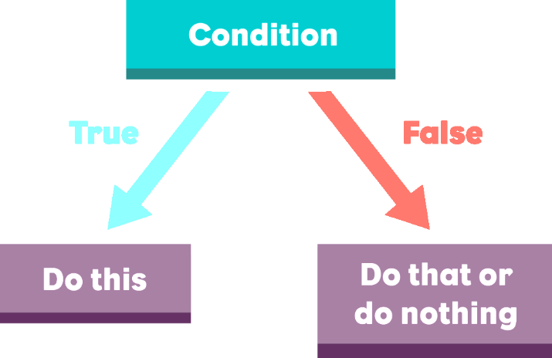
Conditional Statements
Simple Conditions

Slide 18
Code Block
Instructions between { } form code block
#include <stdio.h>
#include <stdlib.h>
int main() {
char text[25];
scanf("%s", text);
printf("%s", text);
return 0;
}

Slide 19
Simple Conditions
In programming checking data values and taking actions according to the result is an important operation
Logical value
Code block to be executed only if the logical value is true
if (...) {
// code
}
19

Slide 20



Example: Excellent Result
Write down a program:
Read grade from the console
Check the grade value and create specific execution paths
Print "Excellent", if the grade is not less than 5.50
Examples:
4
No output
5.50
Excellent

Slide 21
Read input
No output
grade >= 5.50
false
true
Print output
21

Slide 22
Basic Use of If-else
The else statement's block of code is executed only if the previous statement(s) were elevated to false
if (...) {
// code block
} else {
// code block
}
else code block
22

Slide 23
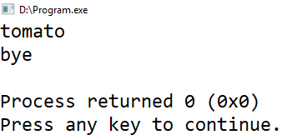
Statement Block
Good practice is when each statement has strict block of code defined to be executed with { } brackets
char color[10] = "red";
if (0 == strcmp(color, "red"))
printf("tomato\n");
else if (0 == strcmp(color, "yellow"))
printf("banana\n");
printf("bye\n");
This line is executed in each case

Slide 24
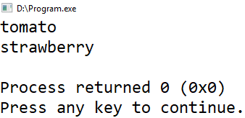
Statement Block
Strict definition of statement block makes the code easier to read
char color[10] = "red";
if (0 == strcmp(color, "red")) {
printf("tomato\n");
printf("strawberry\n");
} else if (0 == strcmp(color, "yellow")) {
printf("banana\n");
printf("bye\n");
}
Only the code inside the block is executed

Slide 25

Greater Number
Program that:
Reads two numbers
Prints "Greater number: "
And the grater of the numbers
Examples:
5
8
7
3
8
7

Slide 26
Read input
Print output
num1 > num2
false
true
Print output
Submit your solution: https://judge.softuni.bg/Contests/Practice/Index/2278#1
26

Slide 27


Even or Odd
Program that:
Checks if number is even or odd
If it is even print - "even"
If it is odd print - "odd"
Examples:
4
even
7
odd

Slide 28
Even or Odd – Solution
int num;
scanf("%d", &num);
if (num % 2 == 0) {
printf("even\n");
} else {
printf("odd\n");
}
28

Slide 29

Chaining If-else

Slide 30

Chaining If-else
if/else-if/else… can be chained
Important here is to note that if one of the condition is true none of the rest will be checked or executed
if (...)
// statement code
else if (...)
// statement code
else (...)
// statement code
30

Slide 31
Chaining If-else – Example
Here the first condition is true so the program will execute
the following block and then skip the rest statements
int a = 7;
if (a > 4) {
printf("Bigger than 4\n");
} else if (a > 5) {
printf("Bigger than 5\n");
} else if (a == 7) {
printf("Equal to 7\n");
}
The output is: "Bigger than 4"
31

Slide 32
Number 1…9 to Text
Program that:
Reads a number
Checks the number in the range [1,9]
If the number is greater than 9 print "number too big"
Otherwise print the number name
Examples:
7
seven
10
number too big

Slide 33
Number 1…9 to Text – Solution
int num;
scanf("%d", &num);
if (num == 1) printf("one\n");
else if (num == 2) printf("two\n");
else if (num == 3) printf("three\n");
// TODO: add more conditions
else printf("number too big\n");
33

Slide 34
Conditional Statements
Live Demo

Slide 35

Variable Scope

Slide 36
Variable Scope
Part of the code where the variable is usable
Example: variable salary is declared only for the if-statement code block
char current_day[10] = "Monday";
if (strcmp(current_day, "Monday") == 0) {
double salary;
scanf("%lf", &salary);
}
printf("%lf\n", salary);
// Error!
36

Slide 37
Area of Figures
Program that:
Reads the type of geometric shape ("square", "rectangle", "circle" or "triangle")
Calculates the area of that shape
Examples:
square
5
25
rectangle
7
2.5
17.5

Slide 38
Area of Figures – Solution
if (strcmp(figure_name, "square") == 0) {
double side;
scanf("%lf", &side);
printf("%.3lf", side * side);
} else if (strcmp(figure_name, "rectangle") == 0) {
double side_a, side_b;
scanf("%lf %lf", &side_a, &side_b);
printf("%.3lf", side_a * side_b);
} else if (...) {
//TODO: Add more conditional statements
}
38

Slide 39
Conditional Statement Switch-case
Similar to if/else if/else if…
Variable to be compared
switch (...) {
case ...: …:
// code
break;
case ...:
// code
break;
default::
// code
break;
}
Conditions where the comparison must be elevated to equality
Default code will be executed only if none of the cases was equal to the value of the variable

Slide 40
Day of Week
Program that:
Reads a number
Prints on the console the name of the day of the week corresponding with the number [1…7]
Prints "Error", if the number is outside of the range
Examples:
1
Monday
4
Thursday

Slide 41
Day of Week – Solution
int day;
scanf("%d", &day);
switch (day) {
case 1:
printf("Monday\n"); break;
case 2:
printf("Tuesday\n"); break;
//TODO: check the other days
case 7:
printf("Sunday\n"); break;
default:
printf("Error\n"); break;
}

Slide 42
Multiple Cases for Single Code Block
Using switch-case there may be multiple cases to execute the same code
switch (...) {
case ... :
case ... :
casе ... :
// code
break;
default:
// code break;
}
The code will be executed if any of the three cases is equal to the variable

Slide 43

Debugging
Using Code::Blocks Debugger

Slide 44
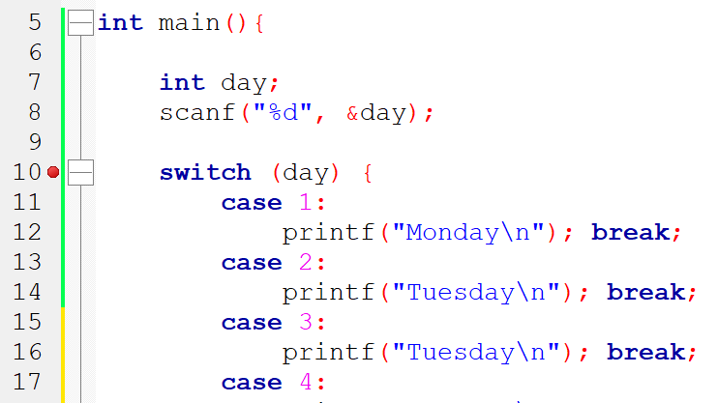
Debugging
Tracing the program execution path and variables values
Makes fixing bugs easier
Breakpoint
44

Slide 45
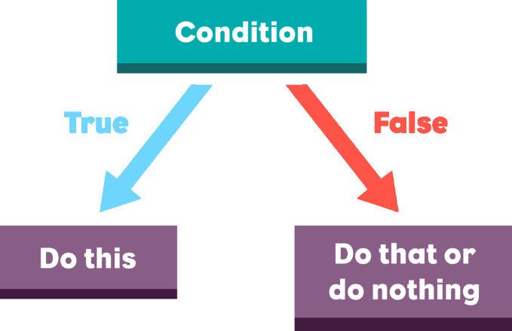
Conditional Statements
Exercise

Slide 46

Summary
Conditional statements – if-else
The switch-case statement
Variable scope
Debugging
…
…
…

Slide 47
Questions?
Notes:
47

Slide 48












SoftUni Diamond Partners

Slide 49




SoftUni Organizational Partners

Slide 50
Trainings @ Software University (SoftUni)
Software University – High-Quality Education, Profession and Job for Software Developers
softuni.bg, softuni.org
Software University Foundation
softuni.foundation
Software University @ Facebook
facebook.com/SoftwareUniversity
Software University Forums
forum.softuni.bg
50
Notes:
50

Slide 51

License
This course (slides, examples, demos, exercises, homework, documents, videos and other assets) is copyrighted content
Unauthorized copy, reproduction or use is illegal
© SoftUni – https://softuni.org
© Software University – https://softuni.bg
Notes:
51

